Slide 1
Step into the Internet of Things with Azure IoT, Stream Analytics and PowerBI
Johan Ludvig Brattås
December 2016

Slide 2

About me
Johan Ludvig Brattås
Johan-ludvig.brattas@capgemini.com
@intoleranse
Managing consultant, Capgemini Norway
SQLSaturday Oslo
Excel BI virtual chapter

Slide 3
Agenda
IoT
Azure IoT Suite
Solutions
Architecture
Components
Stream Analytics
Introduction
Language
Debugging
PowerBI
Q&A

Slide 4
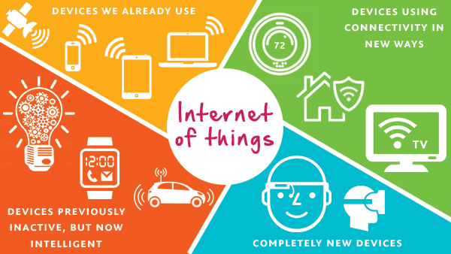
IoT
Notes:
How many know what IOT is? (Should be most)

Slide 5
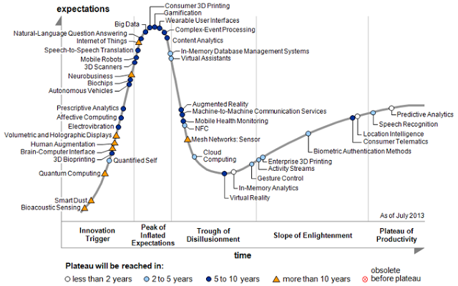
IoT
Notes:
How many know what IOT is? (Should be most)

Slide 6
IoT
Considerations for your IoT enviroment
Devices
Architecture
Cloud
Field gateways
Security

Slide 7
Solution Architecture
Devices and Data Sources
Data Transport
Device and Event Processing
Presentation
Cloud Gate-way
Data Visualization & Presentation
IP capable devices
Provisioning API
Solution Portal
Device State Store
Agent Libs
Identity & Registry Stores
Existing IoT devices
Stream Event Processor
Agent Libs
Gateway
Storage
Analytics/ Machine Learning
Low power devices
Agent Libs
Control System Worker Role

Slide 8
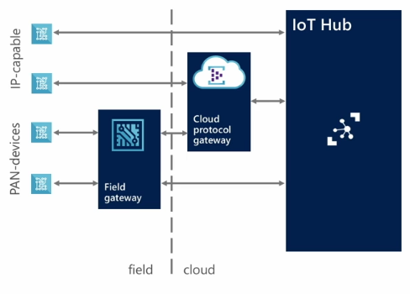
Considerations - Device
Protocols: What protocols are your devices able to communicate with? It needs to be established whether it is supported by the cloud gateway or will require a custom protocol gateway. In addition, what physical networking protocol is it using? Can it support an IP based network?
Platforms: Are your devices compatible with one of the many supported platforms?
Communication: Does your devices support one- or two-way communication?
Notes:
What devices do we have? Do we have «intelligent devices» allready? Are we building something new? Should we include «intelligent devices»?
When thinking about Protocols we need to consider two areas.
What messaging protocol are our devices able to communicate using? One of the IoT Hub supported protocols (AMQP, HTTP AND MQTT)? Or does it use a proprietary protocol that we’ll need to broker either in the field or in the cloud?
What physical networking protocol does the device use? Many devices, particularly smaller devices, may be using lightweight PAN networks to communicate (BT/BTLE/Zigbee,6LoWPAN) and will need a device in the field (a field gateway) to connect them to an IP based network and then to the Cloud.
Should we include both C2D AND D2C or just D2C?
What programming platforms are going to be used? Will you be able to port one of the Azure IoT client SDKs across to your device? Or are we going to have to port the C library across to the platform?
What security requirements are required, in particular, what approach is going to be taken to authentication between device and cloud?

Slide 9
Considerations - Cloud
Telemetry: How will you be monitoring your devices? What outputs do you require for analysing data from the hub?
Device Business Logic: How will your devices process commands and software updates?
Management: Devices being provisioned need to be managed correctly by the hub. How will this be maintained and updated?
Notes:
When considering what will need to be achieved in the cloud:
What are the types and volumes of data to be processed? Some cloud IoT platforms are more capable than others when it comes to high volume telemetry ingestion; indeed some require using two different paths for device command and control vs telemetry ingestion.
How will your device deal with command and control requirements and how will you manage and update devices in the field. Having a suitable mechanism for remote update of devices will be critical in most scenarios; much of the value of low cost IoT devices will be lost if they require a technician to visit them in the field for updates; silicon has gotten much cheaper but technician labor costs have not.

Slide 10
Considerations - Field Gateways
Communication assistance
Secure data flows edge <-> cloud
Protocol translation
Data buffering
Transparent vs. Opaque
Manage connectivity cost
Data filtering
Data batching/aggregation
Device management
Provisioning
Updates
Notes:
Often we’re dealing with very small devices which are not IP capable – so we need a field gateway. Azure IoT supports field gateways and offers example code for a field gateway.
Azure Protocol Gateway: https://github.com/Azure/azure-iot-protocol-gateway/blob/master/README.md
Data buffering – Holding messages locally in the field, the gateway provides connectivity up to the cloud.
Transparent: throttle/quotas apply to the individual devices (as opposed to opaque); has implications for spoofing/identity registry as well

Slide 11
Considerations - Security
What security is built into your devices
Firewalls
Internet Gateways
Encryption
Notes:
IoT devices in general aren’t protected…
Tests by security experts show IoT enabled security cameras being infected within minutes (98 seconds) after being connected to the net…
The MIRAI malware uses telnet to spread itself.
Attack in September against Brian Krebbs had a botnet of IoT cameras and pvr’s around the size of 1 million bots delivering 665GBs of traffic…
So, do you know if your devices are secure?
Put them behind firewalls
If possible, change passwords and disable services (not all devices have this feature)
Consider placing an internet gatweay between the device and the net – even if behind a firewall
Consider encryption

Slide 12
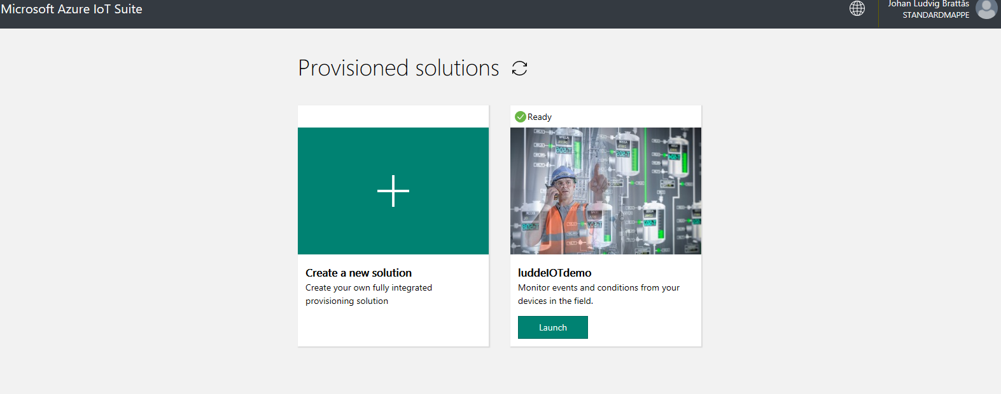
Azure IOT Suite
www.azureiotsuite.com
Notes:
Onwards to the cloud side.
Azure IOT Suite being the de-facto reference architecture for two different IoT scenarios.
Predictive Maintenance
Remote monitoring
Fully scripted depolyment of the whole scenario. All scripts and code available on Github https://github.com/Azure/azure-iot-remote-monitoring
Need an active Azure subscription, though a free test or MSDN subscription will do.
Scaled to high throughput, so expensive – able to scale down a few levels, but not as cheap as when creating everything from scratch using free tiers.
I’ve used the remote monitoring solution for this session.

Slide 13
Solution Architecture – IoT Services
Azure IoT Suite Remote Monitoring
Web/Mobile App
Power BI
Devices
Back end systems and processes
Storage blobs
DocumentDB
IoT Hub
Stream Analytics
Event Hub
Web Jobs
Logic Apps
Azure
Active Directory
Notes:
Mapping this to the Azure IoT suite, we are discussing Azure IoT Hubs. These are the service used to connect devices (or gateways) to the cloud for bi-directional message transfer and device management.

Slide 14
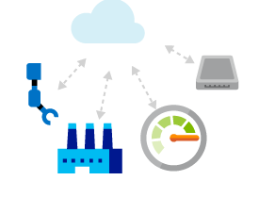
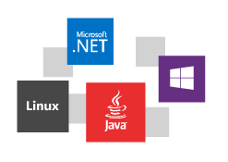
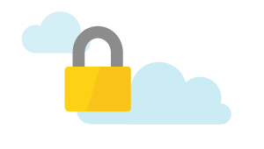
IoT Hub at a glance
Establish bi-directional communication with millions of IoT devices
Work with platforms and protocols that you know
Authenticate per device for security-enhanced IoT solutions
Based on Azure Event Hubs technology; delivering tens of billions of messages per day
Notes:
IoT Hubs provides a bi-directional communications and management mechanism targeting scale into the millions of devices.
They are designed to support existing platforms and protocols and the set of supported platforms and protocols will grow over time. Where a specific platform or protocol is not ‘supported’ they are easily extensible.
They provide per device authentication to allow for enhanced security of field deployed solutions.
Finally; it is important to note that IoT Hubs are based on Event Hubs technology; these deliver tens of billions of messages today and are a very well proven cloud based messaging platform.
There IS a limit to IoT hub throughput. Using it for credit card transactions for instance can lead to scaling issues… 22000 messages per sec and performance will decrease…

Slide 15
What’s supported?
Platforms
Protocols
Languages
Windows, iOS, Android
HTTPS
.NET
Linux/Unix OS Platforms
AMQP
Java
Mbed OS/TI-RTOS/Win Embedded
MQTT
Node.js
Notes:
If we look at the various supported technologies for working with IoT Hubs.
We’ll start with protocols. At the end of the day, even if *your* solution doesn’t use one of the other Platforms, protocols or Languages, so long as it is able to communicate using HTTP it will be able to work with Azure IoT Hubs. IoT Hubs also supports Advanced Messaging Queuing Protocol (AMQP) and MQTT (MQ Telemetry Transport)
In terms of platform support for the devices themselves, Azure provide high level SDKs for various operating systems; Windows, iOS, Android as well as a broad set of Linux OS’s. Azure also support smaller footprint OS’s such as Arm mBed and Real Time Operating Systems. Finally MS provide a very lightweight (runs in kb of memory) C library that you can port to the client device.
ON the service side MS provide prebuilt SDKs for .NET, Java and Node. As noted above; MS can use HTTP to work with IoT Hubs from any platform.

Slide 16
Solution Architecture
Azure IoT Suite Remote Monitoring
Web/Mobile App
Power BI
Devices
Back end systems and processes
Storage blobs
DocumentDB
C# simulator
IoT Hub
Stream Analytics
Event Hub
Web Jobs
Logic Apps
Azure
Active Directory
Notes:
We’ve already discussed IoT Hubs in detail. Now let’s talk about Stream Analytics, Event Hubs, and the portal that ships as part of the preconfigured solutions.
Stream Analytics for aggregation, analysis and triggers – and the sinks. More on Stream Analytics later.
Event Hubs for acting on triggers from SA
Cold and Hot paths
DocumentDB as Device database – metadata repository. Historical referencing
WebApp for delivering data and managing devices. Show web page
Mention Azure AD
Mention Logic apps and Automation

Slide 17

Stream Analytics
A subset of T-SQL
Positive: Familiar syntax, easy to use if familiar with T-SQL
Negative: Subset – you will hit limitations quickly
Major difference:
Time-handling (TIMESTAMP BY + windows)
Windowing

Slide 18
Stream Analytics
DEMO
Notes:
Demo of data types and syntax. Limitations. Syntax checker.
Create PowerBI sink, use Tumbling window aggregation. Explain why aggregation is needed for PowerBi sink

Slide 19

Stream Analytics
Tumbling window
SELECT TollId, COUNT(*) INTO Output FROM Input
GROUP BY TollId, TumblingWindow(Duration(hour, 1), Offset(millisecond, -1))
Notes:
Temporal Windows - metode for å aggregere data i en strøm av data:
Tumbling window er enklest å forklare...
Tumbling windows are a series of fixed-sized, non-overlapping and contiguous time intervals.
Hopping Window - overlappende vindu. Syntaks "Hopping Window (10,5)" hvor første tallet er lengden på vinduet og andre tallet er hvor lang tid det skal ta før et nytt vindu startes.
Sliding window - Vinduet starter hver gang en hendelse skjer, for tidsintervallet spesifisert i syntaks. Nytt vindu starter neste gang en hendelse skjer, uavhengig av om forrige vindu er avsluttet eller ikke.
Nyttig når det går lang tid mellom hver hendelse, men kan gi forvirring hvis hendelsene kommer fortløpende.

Slide 20
Stream Analytics
Hopping window
Select TopId, Count(*) INTO Output From Input Group By Topid, hoppingwindow (minute, 10, 5)
Notes:
Temporal Windows - metode for å aggregere data i en strøm av data:
Tumbling window er enklest å forklare...
Hopping Window - overlappende vindu. Syntaks "Hopping Window (10,5)" hvor første tallet er lengden på vinduet og andre tallet er hvor lang tid det skal ta før et nytt vindu startes.
Sliding window - Vinduet starter hver gang en hendelse skjer, for tidsintervallet spesifisert i syntaks. Nytt vindu starter neste gang en hendelse skjer, uavhengig av om forrige vindu er avsluttet eller ikke.
Nyttig når det går lang tid mellom hver hendelse, men kan gi forvirring hvis hendelsene kommer fortløpende.

Slide 21
Stream Analytics
Sliding window
SELECT TopId, Count(*) INTO Output FROM Input
GROUP BY SlidingWindow (minute, 10)
Notes:
Temporal Windows - metode for å aggregere data i en strøm av data:
Tumbling window er enklest å forklare...
Hopping Window - overlappende vindu. Syntaks "Hopping Window (10,5)" hvor første tallet er lengden på vinduet og andre tallet er hvor lang tid det skal ta før et nytt vindu startes.
Sliding window - Vinduet starter hver gang en hendelse skjer, for tidsintervallet spesifisert i syntaks. Nytt vindu starter neste gang en hendelse skjer, uavhengig av om forrige vindu er avsluttet eller ikke.
Nyttig når det går lang tid mellom hver hendelse, men kan gi forvirring hvis hendelsene kommer fortløpende.

Slide 22

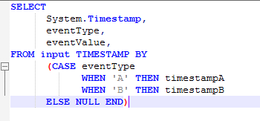
Stream Analytics
TIMESTAMP By Examples:

Slide 23
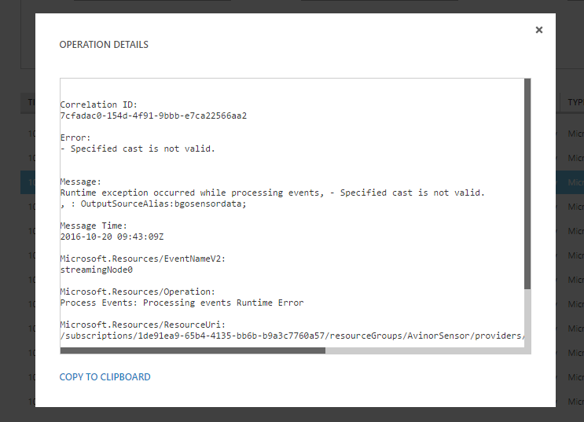
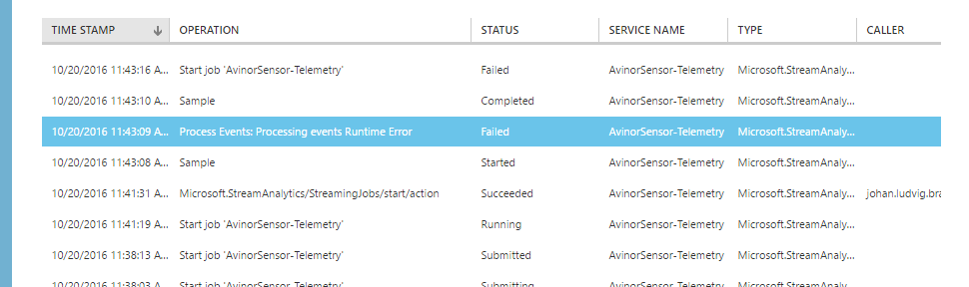
Stream Analytics
Error-handling
Two systems of checks. - Syntax checking as seen in the demo
- Run time parsing (XML?)

Slide 24
PowerBI
Stream Analytics sink/output
Uses the PowerBI.com site to create live dashboards.
As of January 2017 – closed preview of Stream analytics as streaming dataset.
Let’s have a look at how we can create streamed dashboards currently…
DEMO

Slide 25
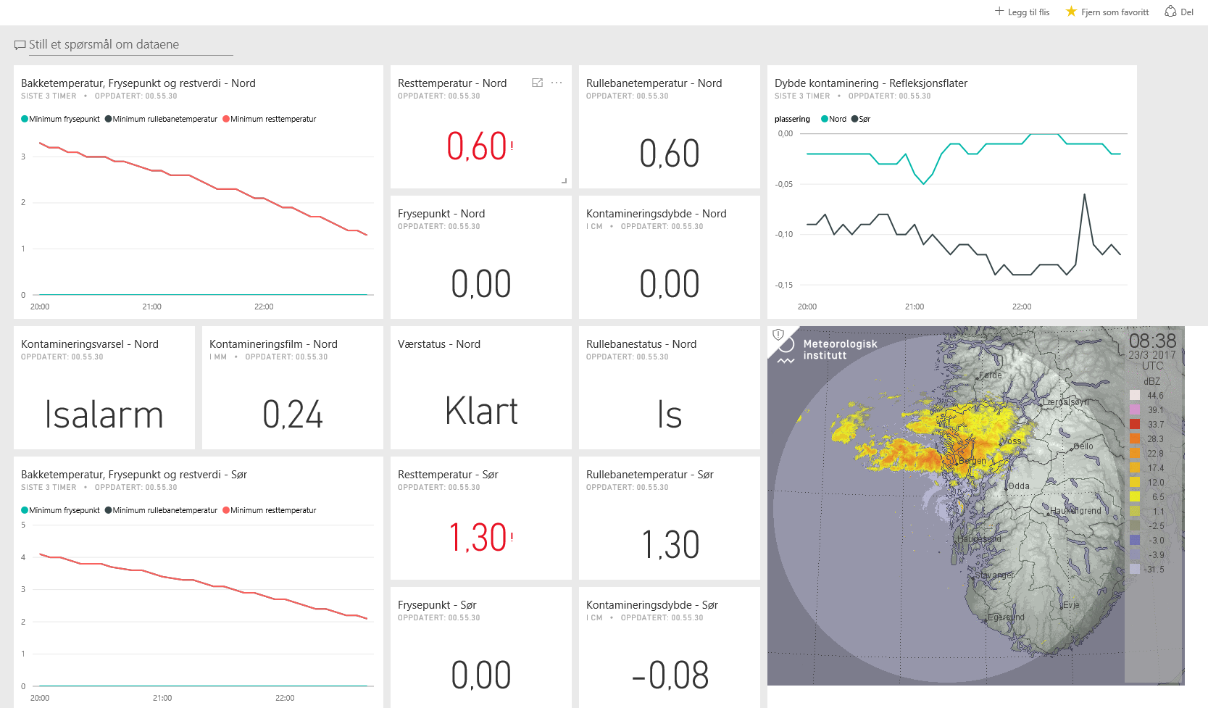
Eksempel på sensordata i PowerBI

Slide 26
Links
https://blogs.microsoft.com/iot/
https://www.azureiotsuite.com/
https://developer.microsoft.com/en-us/windows/iot
https://catalog.azureiotsuite.com/kits
https://github.com/Azure/azure-iot-arduino
https://azure.microsoft.com/en-us/develop/iot/

